Slide 1
4TH FORCE SUPPORT SQUADRON
Outdoor Recreation Seymour Johnson AFB Hunting Program
2023-2024
PROGRAM BRIEF
THIS BRIEFING IS: UNCLASSIFIED
UPDATED 8 DECEMBER 2023

Slide 2
ODR Hunting Program
Program Overview
A limited hunting program is authorized by the 4th Fighter Wing Commander.
Authority to oversee and manage program is delegated to the 4th Mission Support Group (MSG) Commander. Day-to-day execution of the program will be the responsibility of the 4th Force Support Squadron (FSS).
Hunters must acknowledge and comply with all guidance in the most current version of the following:
Addendum to integrated natural resources management plan
AFI 34-110 Seymour Johnson AFB Hunting Program Supplement
Any relevant Security Forces AFI’s relating to firearms
All North Carolina Wildlife Resources Commission hunting regulations

Slide 3
ODR HUNTING PROGRAM
Hunting Seasons
Hunting is permitted during designated seasons in accordance with (IAW) applicable North Carolina hunting rules and seasons and as augmented.
Hunters may only harvest animals during the appropriate season:
Coyote and Feral Hog Season
September 1, 2023 - August 31, 2024
Deer Season
Archery: September 9-29, 2023
Blackpowder: September 30- October 13, 2023
Gun: October 14, 2023 – January 1, 2024
Turkey Season (Wild Turkey – male or bearded turkey only)
Youth-only Season: April 6-12, 2024
Spring Season: April 13 – May 11, 2024

Slide 4
ODR HUNTING PROGRAM
Program Eligibility
Eligible Personnel:
Active duty
Retirees
DoD civilian personnel assigned to SJAFB
Dependents of the above eligible personnel
Valid DOD ID Card is REQUIRED at the time of registration.

Slide 5
ODR HUNTING PROGRAM
Participation Requirements
Requirements for all hunters (18 years or older) on SJAFB:
Meet Eligibility Requirements
North Carolina Big Game Hunting License
North Carolina Hunters Education Training Course (Click here)
SJAFB Outdoor Recreation Annual Sportsman Card
Signed annual release, indemnification, hold harmless, and assumption of risk agreement

Slide 6
ODR HUNTING PROGRAM
Annual Sportsman’s Card
How to obtain your SJAFB Outdoor Recreation Annual Sportsman Card:
Review the 2023-2024 Hunting Program Brief
Complete and pass the 2023 Annual Sportsman’s Test (Click here)
Hunters must score 18 points or higher to pass the 2023 Annual Sportsman’s Test. If a hunter scores less than 18 points, they may select “Edit Response” to retake the test until they receive a passing score.
Bring the following documentation with you to Outdoor Recreation:
DOD ID Card (for proof of eligibility)
North Carolina Big Game Hunting License
Proof of Completion: North Carolina Hunters Education Training Course (Click here)
Payment Method for $10 Sportsman's Card Fee

Slide 7
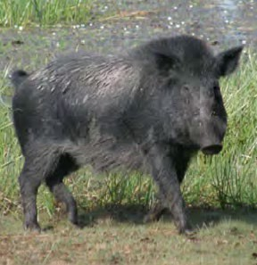
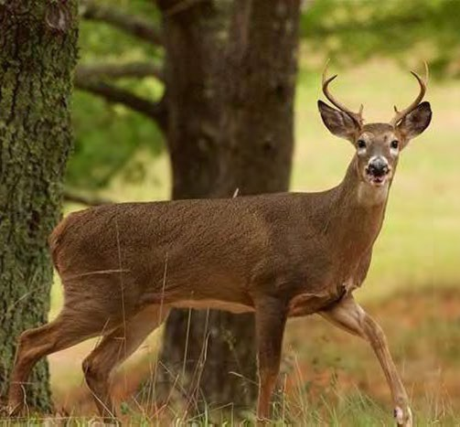
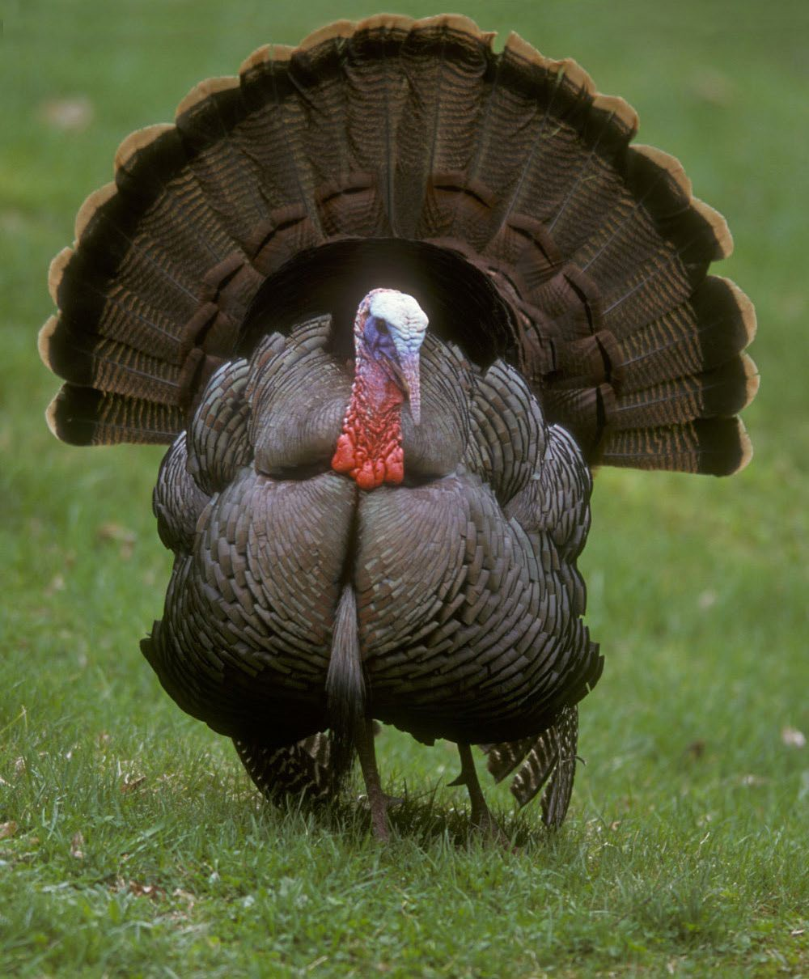
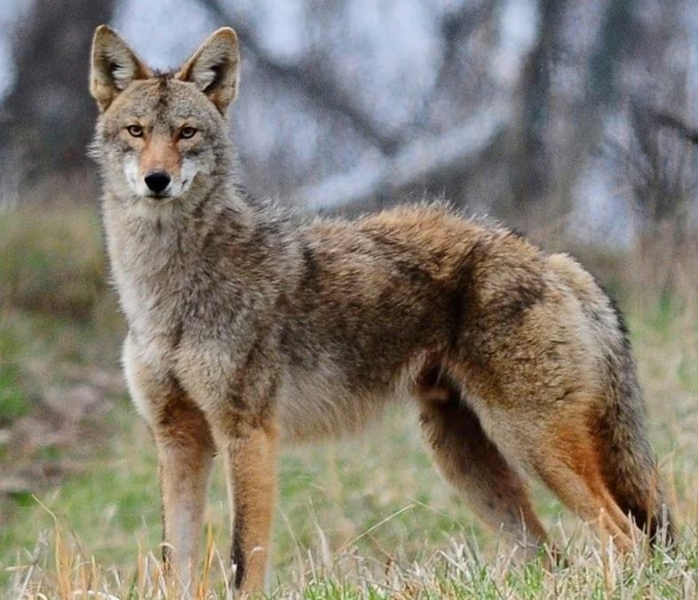
ODR HUNTING PROGRAM
Permitted Game
Whitetail deer, feral hogs, coyote, and spring turkey in all areas during appropriate seasons

Slide 8
ODR HUNTING PROGRAM
Prohibited Actions Regarding Wildlife
The prohibited practices listed below are not all inclusive. Other actions that detract from safety and/or suitable hunter conduct may be added at the discretion of the 4 MSG/CC at any time:
The use of electronic predator callers-
The use of electronic predator callers can pull coyotes in from far distances and could potentially lead to a coyote digging under the airfield fence in search of food. Coyotes digging under the perimeter fence are one of the main mammal hazards we deal with on a regular basis.
Harassing or killing any animals or birds other than deer, feral hogs, coyotes, turkey.
Leaving trash or other litter in area (to include field dressing game and resulting residue)
Not making a reasonable effort to locate/retrieve wounded game

Slide 9
ODR HUNTING PROGRAM
Prohibited Actions Regarding Safety
The prohibited practices listed below are not all inclusive. Other actions that detract from safety and/or suitable hunter conduct may be added at the discretion of the 4 MSG/CC at any time:
Having a loaded gun outside an elevated stand.
Failure to use a safety harness or belt while in elevated stand.
Hunting without a permit, license or hunter safety card, allowing someone else to use your permit and/or area gate key, entering a hunting area without a valid permit; allowing others w/o valid permit to enter hunt area (unless prior approved by FSS personnel to assist in retrieval of game).
Carrying any firearm other than a shotgun or muzzleloader in an hunting area
Having any shotgun shells other than slugs in an area
Failure to check out and return permit/key promptly after hunt

Slide 10
ODR HUNTING PROGRAM
Prohibited Actions: Resulting Disciplinary Actions
Infractions may result in up to one year suspension of base hunting privileges and/or disciplinary action under the UCMJ “and/or administrative action or criminal; prosecution by federal or state authorities.”
The prohibited practices listed in this brief are not all inclusive. Other actions that detract from safety and/or suitable hunter conduct may be added at the discretion of the 4 MSG/CC at any time.
Outdoor Recreation Staff will notify all registered hunters of any changes.

Slide 11
ODR HUNTING PROGRAM
Signing Up to Hunt
Hunting Schedule:
Hunting is only permitted on Mondays, Wednesdays, Saturdays, and Sundays
Authorized hunters may enter their area no earlier than 0400 on day of hunt and may hunt until sunset. Hunters must exit and secure their area NLT 1 hour after sunset.
Dates/times may be modified as needed in order to meet mission requirements of SJAFB. These modifications may be short-notice, ODR will do their best to notify hunters as soon as possible.
Hunters are can check the Hunting Calendar for the most up-to-date availability here.
Reserving a Hunting Area:
Only SJAFB ODR Annual Sportsman Card holders may reserve a hunting area.
All areas will only be signed out to one hunter per day, however, the hunter may bring one additional hunter with them as long as that additional hunter is a SJAFB ODR Sportsman’s Card holder.
Contact Outdoor Recreation to make your reservation.
Reservations are FCFS and can be made one week prior to the requested date.
Hunters can reserve each hunting area once per week.
The daily reservation fee for each hunting area is $5.

Slide 12
ODR HUNTING PROGRAM
Hunting Area Keys
Key Check-Out
Hunters must check out keys to their designated hunting area from the 4 SFS Armory on the day prior to their hunt between 0900-1500.
If your hunting reservation is on a Sunday or Monday, there is a chance that someone is hunting on the day that you are attempting to check out a key. If so, you may have to wait until the key is returned that night or pick up the key early the next morning. You can check the Hunting Calendar to see if another hunter has the key for your area checked out on the day prior to your hunt (Click here)
Key Return
All keys must go back to the 4 SFS Armory before the next hunter can take possession of the key.
All keys are due back to the armory upon completion of hunting on your reserved day, NLT 1 hour after sunset.
IF additional time is required you must notify the 4 SFS Armory IMMEDIATELY.
4 SFS Armory
Address: Building 5006, 1100 Guardian Rd (on the corner of Vermont Garrison and Guardian)
Phone: 919-722-2506

Slide 13
ODR HUNTING PROGRAM
Hunting Day Procedures: Transportation of Firearms and Bows
All individuals transporting a firearm or bow on SJAFB must comply with Installation Security Instructions in AFI 31-101, Integrated Defense, and paragraph 8.12.2.3.4.
Authorized personnel may transport privately owned weapons (POWs) on base for the purpose of getting to and from authorized storage facilities, purchase or sale at collector display events, and authorized sporting events requiring their use.
This includes weapons such as archery bows and arrows, pellet/BB guns, and paintball guns. However, these weapons will not be stored or left unattended in a privately owned vehicle at any time. Seymour Johnson AFB Force Protection Plan 2018 (FPP), Section 3.11
Transportation of Weapons on the Installation states privately owned weapons will always be unloaded and ammunition physically separated from the weapon (e.g. weapon in the trunk (or weapons case) and ammunition in glove compartment).
EXCEPTION: POWs may be transported in the luggage compartment or behind the seat of a pick-up truck if the passenger compartment is full and ammunition must be stored separately. In these cases, the operator must ensure that if contacted by Security Forces (e.g., ID checks, traffic stops), they immediately notify Security Forces of the POWs’ location.
All weapons will be transported directly to and from the hunting area. Non-essential stops are not authorized (e.g., Shoppette, Base Exchange etc.).

Slide 14
ODR HUNTING PROGRAM
Hunting Day Procedures: Start of Reservation Period
Hunters may not enter their Hunting Area earlier than 0400 on day of hunt.
Hunters may only bring ONE gun OR bow into their hunting area.
Vehicles should be parked near hunter entry gate and off road not to impede traffic.
Motorized vehicles are not allowed in hunting areas.
Hunters must re-lock gate after entering area.
If hunting with a fireman(s) hunters will wear hunter safety orange at all times.

Slide 15
ODR HUNTING PROGRAM
Hunting Day Procedures: End of Reservation Period
All hunting stops at sunset.
Hunters must lock the gate, turn in their permit and key to 4 SFS Armory, sign out of area, and identify any game taken no later than (NLT) 1 hour after sunset.
If additional time is required to retrieve downed game, the hunter must notify the 4 SFS Armory immediately.

Slide 16
ODR HUNTING PROGRAM
Hunting Day Procedures: Game Cleaning
Harvesting and Field Dressing
Game will not be field dressed in any of the hunting areas.
The only area on SJAFB that you are allowed to dress an animal is next to the archery area at the Log Cabin.
All discarded guts and carcass pieces must be bagged and discarded in the dumpster at the Log Cabin, or at an appropriate off base location.
Reporting Your Harvest
All harvests must be reported within one hour of sunset on the day of your hunt.
You must report your harvest to BOTH:
Outdoor Recreation (via email) outdoorrecreationsjafb@gmail.com
NC Wildlife Resources Commission (online or at the phone number listed on your hunting license)

Slide 17
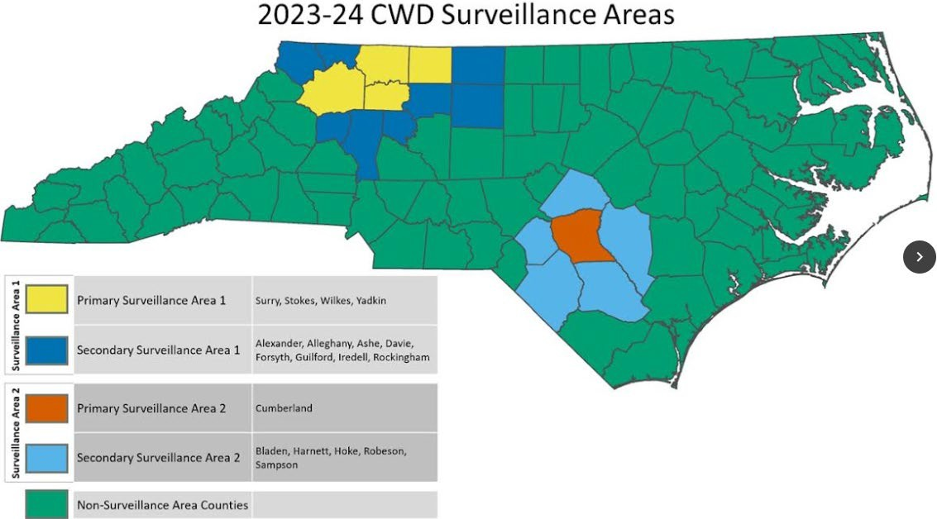
ODR HUNTING PROGRAM
Hunting Day Procedures: Chronic Wasting Disease Testing
What is CWD?
CWD is a disease found in some deer, elk and moose populations. CWD damages portions of the brain and typically causes progressive loss of body condition, behavioral changes, excessive salivation, urination, and death.
Are there health risks for hunters in handling deer with CWD?
There is no evidence to date that hunters have a risk of acquiring CWD.
Is SJAFB located in a CWD Surveillance Area?
Wayne County (indicated with on “ 2023-24 CWD Surveillance Areas Map”) is not a surveillance area, however we are right next to a secondary surveillance county. Deer harvested on SJAFB currently do not have a CWD testing requirement.
Are there testing options available for deer harvested outside of a CWD Surveillance Area?
Yes. Hunters harvesting deer outside of the established PSA and SSA can transport a harvested deer carcass or head to any NCWRC depot or other designated site for CWD testing. The location of NCWRC depots, other testing sites, and potential testing costs will be listed on the NCWRC’s website.

Slide 18
ODR HUNTING PROGRAM
Hunting Areas: Safety Guidelines
Elevated Tree Stands
All deer hunting in all areas must be from an elevated or tree stand at least 10 feet above ground level – this includes portable climbing and ladder type stands.
It is prohibited to erect any tree stand or platform attached by nails, screws, bolts, or wire to a tree on the installation
This does not apply to portable tree stands that are removed after each use with no metal left in or attached to the tree
Hunters using an elevated tree stand, or portable climbing stands, must exercise safety precautions and assure the safe and proper use of the stand and must wear a fall restraint, safety belt, or harness.
All stands must face away from fence – do not fire a weapon towards the base.
Shotguns/ Muzzle-Loading Rifles/ Muskets
May ONLY be used when hunting from FSS’s pre-positioned stands (in areas A and B only)
May NEVER be used in Areas C and D
Are not permitted outside of Elevated Tree Stands when loaded.
Loaded for a shotgun = having a shell in chamber, barrel, or magazine
Loaded for a muzzleloader = having a primer, cap, or other ignition device in place on weapon with a powder charge in barrel

Slide 19
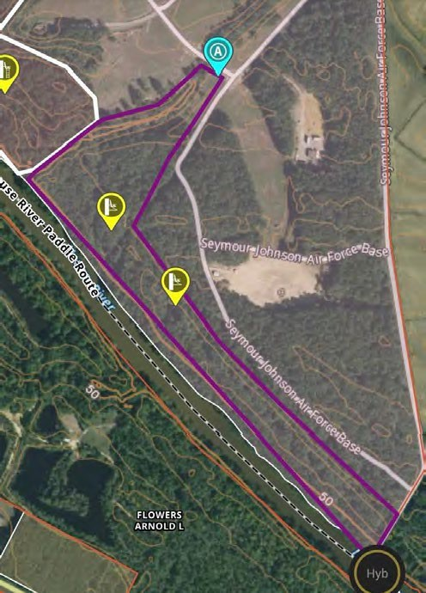
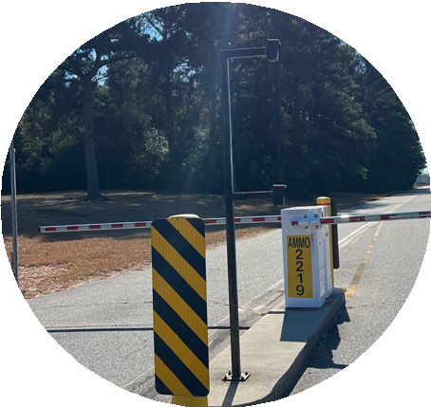
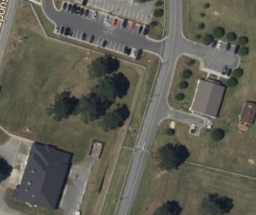
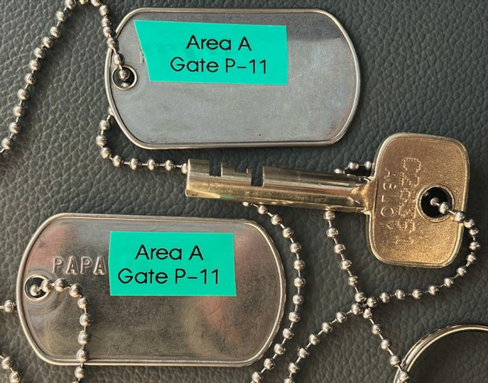
ODR HUNTING PROGRAM
Hunting Areas: Area A (Gate P-11)
Area Location
Located south and west of Explosive Ordnance Disposal range. Bordered on east and north by Explosive Ordnance Disposal range fences. Bordered on west by a creek and on south by Neuse River.
Hunter entry/exit gate is P-11, located on northeast end of area. Coordinates: 35.329603, -77.973189
Area Access
To access Area A, Hunters will need to pass through the Ammo drop-arm gate on the Flightline perimeter road.
While picking up the keys at the Armory, Hunters will also need to ask for the code to the AMMO #2219 gate. Located just past BLDG# 2219.

Slide 20
ODR HUNTING PROGRAM
Hunting Areas: Area A (Gate P-11)
Area Special Instructions/ Restrictions
Hunting will not be allowed in Area A during M203 weapons training, Security Forces will notify Outdoor Recreation when this occurs and ODR will contact customers as soon as possible.
Turkey hunting may be conducted from ground blinds ONLY if hunters are using archery equipment.
Authorized Weapons
Archery equipment – all season.
Shotguns – during appropriate part of season, with slugs or buckshot only (deer/hogs/coyote) and 5 shot (turkey). See Slide 3: Hunting Seasons for more information.
Muzzle loaders – during appropriate part of season. See Slide 3: Hunting Seasons for more information.

Slide 21
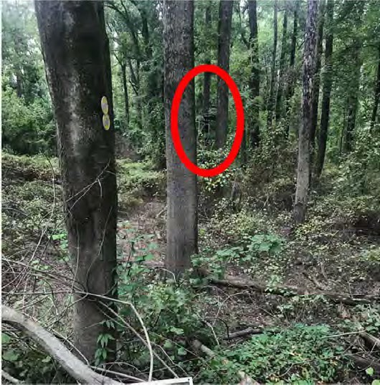
ODR HUNTING PROGRAM
Hunting Areas: Area A (Gate P-11)
Tree Stand Locations/ Access
To access stands, enter hunting area and walk alongside of the fence into the woods.
When you reach the tree pictured, the yellow stand will be to your right, this is the only marked stand.
The second stand is further down the fence line, turn left at the opening and the stand will be about 100 yards away on the right.

Slide 22
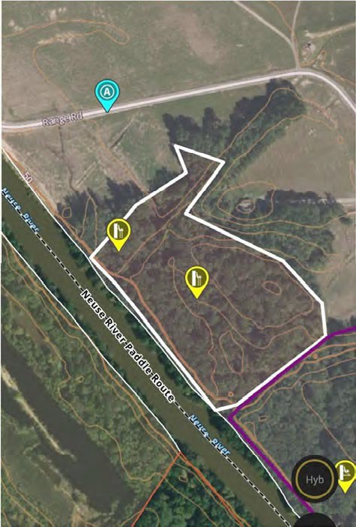
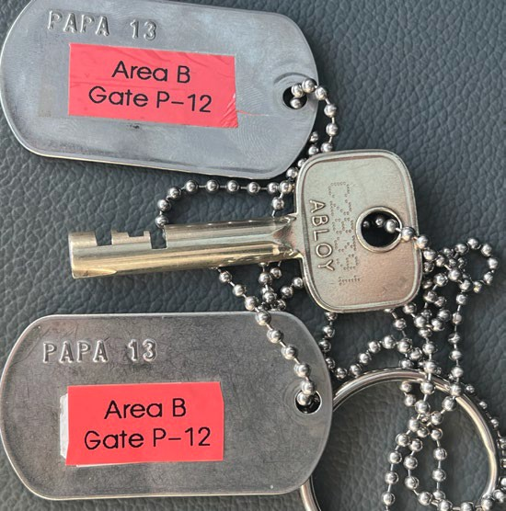
ODR HUNTING PROGRAM
Hunting Areas: Area B (Gate P-12)
Area Location
Located between airfield and Area A, bordered on west and north by base perimeter fence, bordered on east by a creek (dividing areas A & B) and on south by Neuse River.Annex to include yellow highlighted area.
Hunter entry/exit gate is P-12, loaded on northwest end of area. Coordinates: 35.330599, -77.974820
Hunters will enter the gate and walk across the field into the hunting area.
Area Access
To access Area B, Hunters will need to pass through the Ammo gate on the Flightline perimeter road.
While picking up the keys at the Armory, Hunters will also need to ask for the code to the AMMO #2219 gate. Located just past BLDG# 2219.

Slide 23
ODR HUNTING PROGRAM
Hunting Areas: Area B (Gate P-12)
Area Special Instructions/ Restrictions
Turkey hunting may be conducted from ground blinds ONLY if hunters are using archery equipment.
Authorized Weapons
Archery equipment – all season.
Shotguns – during appropriate part of season, with slugs or buckshot only (deer/hogs/coyote) and 5 shot (turkey). See Slide 3: Hunting Seasons for more information.
Muzzle loaders – during appropriate part of season. See Slide 3: Hunting Seasons for more information.

Slide 24
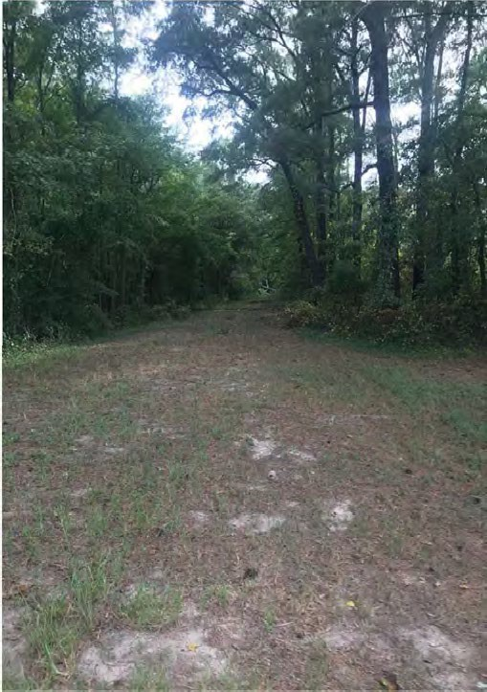
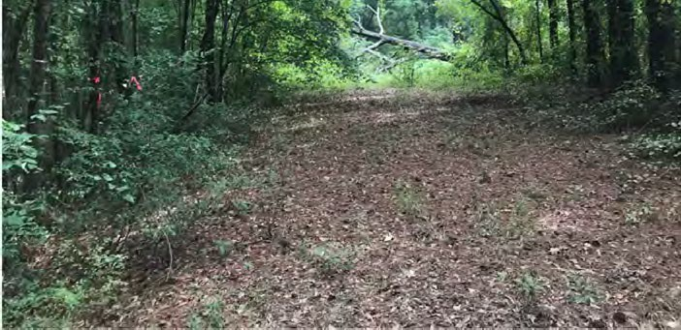
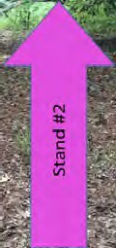
ODR HUNTING PROGRAM
Hunting Areas: Area B (Gate P-12)
Tree Stand Locations/ Access
Area B has two stands, both marked by pink ribbon. Follow pink markers all the way to each stand
Stand #1 drops into a ditch about 15 feet down using a rope to assist your descent, then back up a hill into an opening
Stand #2 is straight down the opening to the very end on the right-hand side

Slide 25
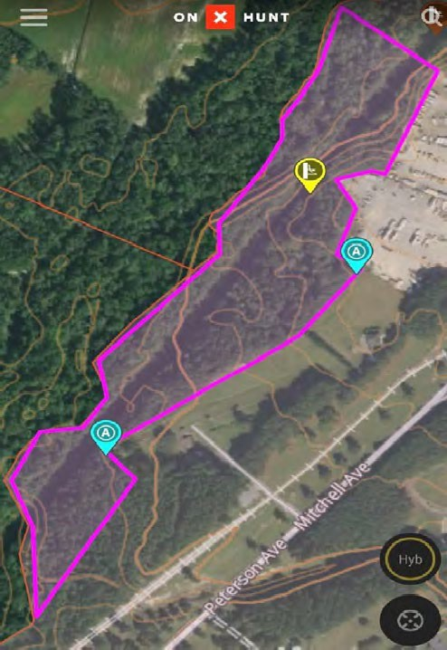
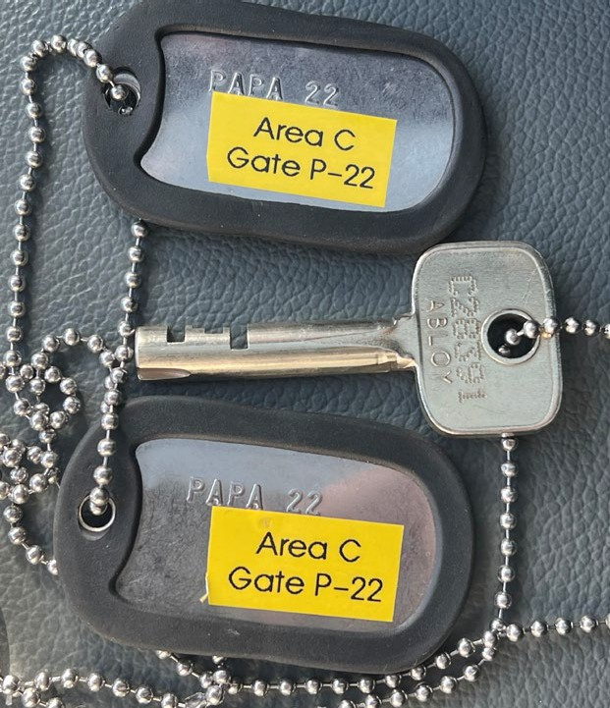
ODR HUNTING PROGRAM
Hunting Areas: Area C (Gate P-22)
Area Location
Located between base perimeter fence and Stoney Creek, northwest of RV and contractor storage lots, bordered on west by Stoney Creek and on north by unknown creek that runs through base fence.
Area C ends at northwest border of RV Storage lot by an invisible line drawn due west from southwestern most corner of storage lot to Stoney Creek
Hunter entry/exit gate is P-22, Located behind the Warrior Pines Log Cabin. Coordinates: 35.351487, -77.977986
Area Special Instructions/ Restrictions
Archery ONLY
No pre-positioned stands, hunters must bring their own portable stands
Turkey hunting may be conducted from ground blinds
Authorized Weapons
Archery equipment – all season.

Slide 26
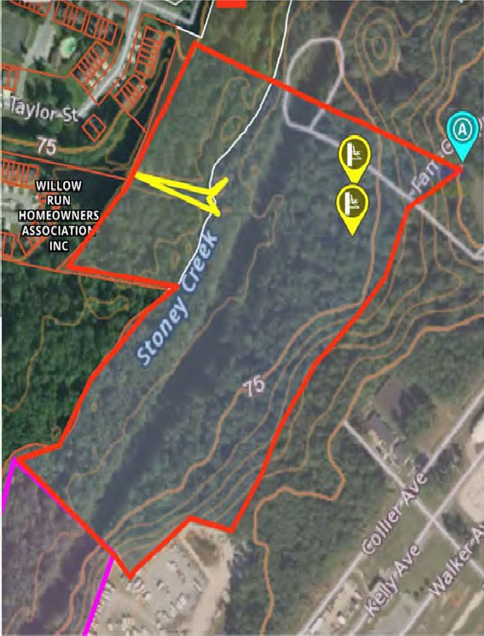
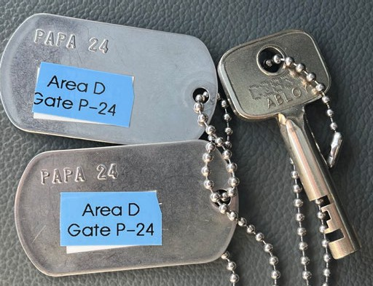
ODR HUNTING PROGRAM
Hunting Areas: Area D (Gate P-24)
Area Location
Located between base perimeter fence and Stoney Creek, northeast of RV and contractor storage lots.
Bordered on west by Stoney Creek and on north by unknown creek that runs through base fence and under walking bridge north of FAMCAMP.
Bordered on east by a base fence and on southwest by an invisible line drawn from southwestern most corner of RV Storage lot to Stoney Creek.
Hunter entry/exit gate is P-24, located just past FamCamp. Coordinates: 35.360230, -77.968552
Area Special Instructions/ Restrictions
Archery ONLY
Turkey hunting may be conducted from ground blinds
Authorized Weapons
Archery equipment – all season.

Slide 27
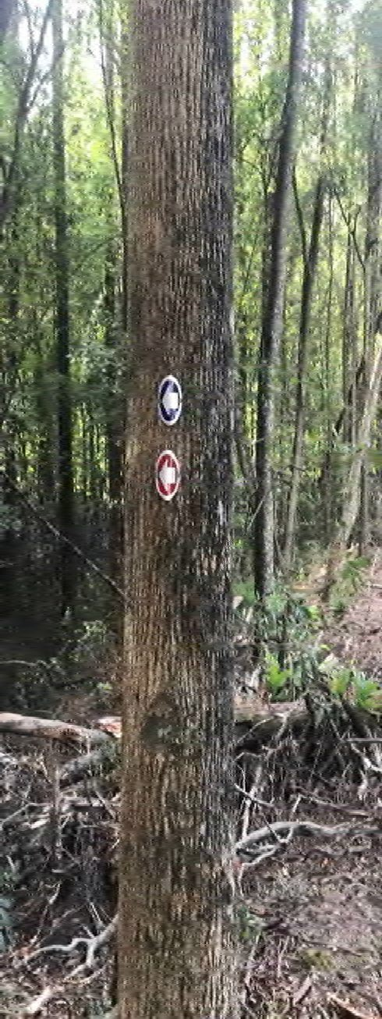
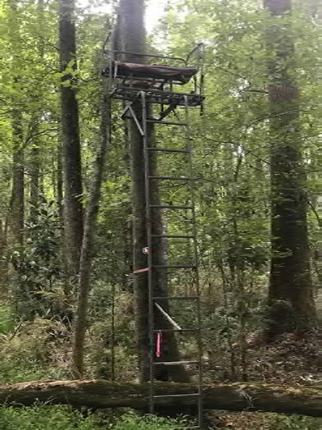
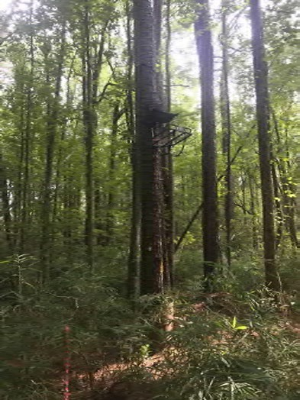
ODR HUNTING PROGRAM
Hunting Areas: Area D (Gate P-24)
Tree Stand Locations/ Access
Area D has 2 pre-positioned stands, the Red Stand and the Blue Stand
Enter hunting area, continue along fence past the yellow protective poles until you reach pictured tree (right)
Red Stand
After dropping into the woods, you will find this stand about 50 yards into the wood line, straight ahead
Blue Stand
After dropping into the woods, you will walk past the red stand and veer left, following the blue placards. The trail weaves left and right, move slowly.
Go down the drop off to the left into the woods

Slide 28
ODR HUNTING PROGRAM
Points of Contact
QUESTIONS?
Questions about the SJAFB Hunting Program/ Sportsman’s Cards:
Outdoor Recreation (919) 722-1104
OutdoorRecreationSJAFB@gmail.com
Questions about Hunting Area Keys/ Drop-Arm Gate Codes:
4SFS Armory
919-722-2506
Questions about the SJAFB Integrated Natural Resources Management Plan (INRMP):
Natural Resources Manager Robert Montgomery
(919) 722-1011
robert.montgomery.1@us.af.mil
Questions about North Carolina Big Game Hunting Licenses: North Carolina Wildlife Resource Commission www.ncwildlife.org/Licensing/Hunting-Fishing-Trapping-Licenses 833-950-0575

